Slide 1
Design and implement the serving layer

Slide 2
Agenda
Design a multidimensional schema to optimize analytical workloads
Populate slowly changing dimensions in Azure Synapse Analytics pipelines
Perform code-free transformation at scale with Azure Data Factory or Azure Synapse Pipelines
Notes:
TALKING POINTS
Let’s set an agenda for today’s presentation in which we are going to discuss the following:
Design a multidimensional schema to optimize analytical workloads
Populate slowly changing dimensions in Azure Synapse Analytics pipelines
Perform code-free transformation at scale with Azure Data Factory or Azure Synapse Pipelines
PRESENTER NOTES AND GUIDANCE
Don’t take too much time in order to present the agenda. Make the points in the topics.

Slide 3
Design a multidimensional schema to optimize analytical workloads
1
Notes:
TALKING POINTS
Let’s go over fundamental data modeling for optimizing analytical workloads. How many of you have heard of a star or snowflake schema?
PRESENTER NOTES AND GUIDANCE
Poll your audience.

Slide 4
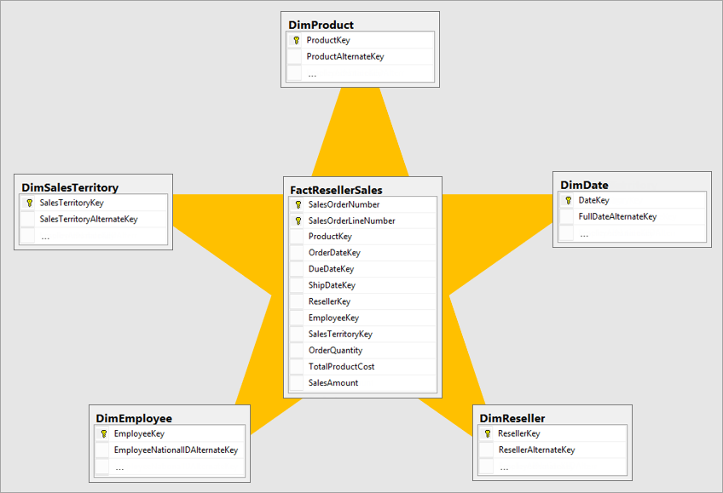
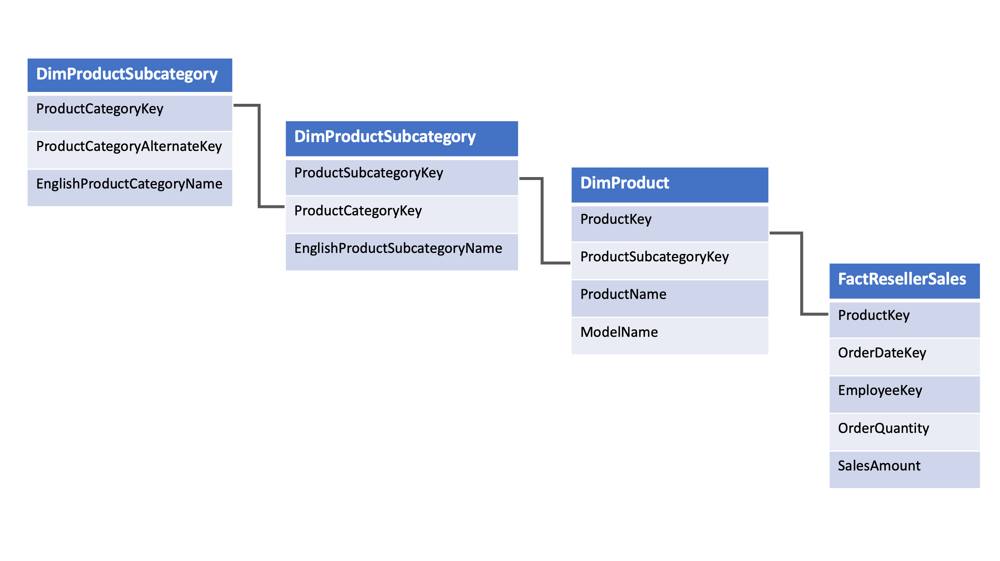
Design a multidimensional schema to optimize analytical workloads
Notes:
Talking points
(Click 1)
Dimension tables
Dimension tables describe business entities—the things you model. Entities can include products, people, places, and concepts including time itself. The most consistent table you'll find in a star schema is a date dimension table. A dimension table contains a key column (or columns) that acts as a unique identifier, and descriptive columns. Dimension tables contain attribute data that might change but usually changes infrequently.
Fact tables
Fact tables store observations or events, and can be sales orders, stock balances, exchange rates, temperatures, etc. A fact table contains dimension key columns that relate to dimension tables, and numeric measure columns. The dimension key columns determine the dimensionality of a fact table, while the dimension key values determine the granularity of a fact table. For example, you have a sales fact table with two dimension key columns: Date and ProductKey. This table has 2 dimensions, but since the values stored in the Date column are the first day of the month, the granularity is at the month-product level.
It is not uncommon to have multiple fact tables within a single data warehouse to answer a range of business questions.
(Click 2)
(Click 3)
Snowflake schema
The snowflake schema is a set of normalized tables for a single business entity. It aims to normalize the data to reduce the repetition in the data and therefore the space taken up by the data, leading to fewer IO requests making it quicker to retrieve the data in queries.
In reality, typical data warehouse solutions have a hybrid of the two schemas to fulfill analytical requirements.
Instructor notes and guidance.
This slide is a build slide
Click 1 – brings in the star schema graphic
Click 2 – the star schema graphic disappears
Click 3 – the snowflake schema graphic appears

Slide 5
Populate slowly changing dimensions in Azure Synapse Analytics pipelines
2

Slide 6
Slowly changing dimensions
A slowly changing dimension is one that appropriately manages the change of dimension members over time.
Applies when the values of a business entity change over time and not on a schedule.
In contrast, dimensions like a stock’s market price are considered rapidly changing.
Notes:
A slowly changing dimension (SCD) is one that appropriately manages the change of dimension members over time.
It applies when the values of a business entity change over time, and not on a set schedule.
A good example of an SCD is a customer dimension, specifically its contact detail columns like email address and phone number.
In contrast, some dimensions are considered to be rapidly changing when a dimension attribute changes often, like a stock's market price.
The common design approach in these instances is to store rapidly changing attribute values in a fact table measure.
However, for slowly changing dimensions the changing members should remain in the dimension table.
The design used for handling SCDs depends on the business requirements for the dimension table.

Slide 7
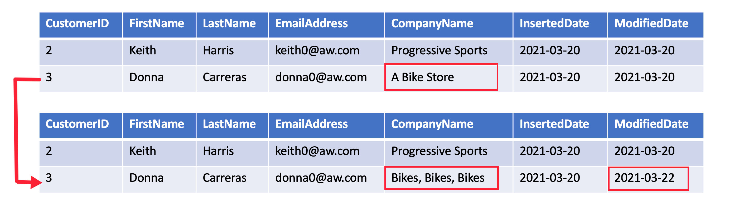
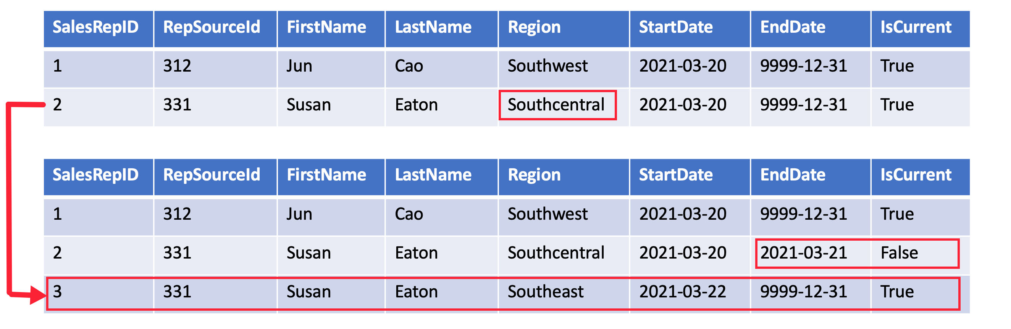
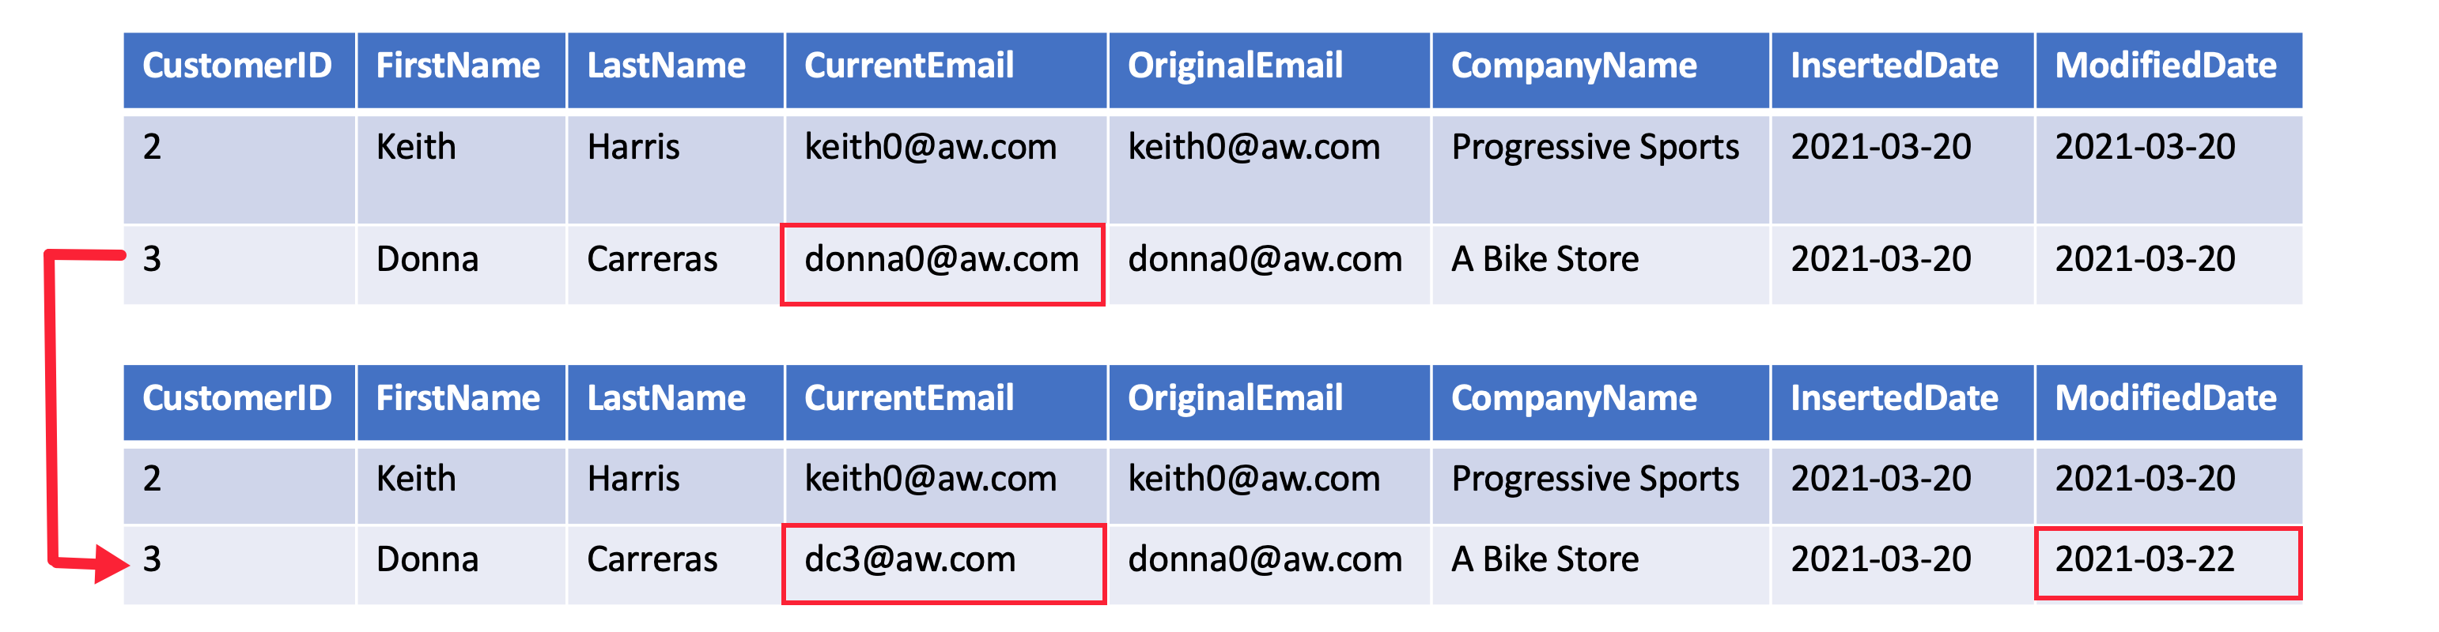
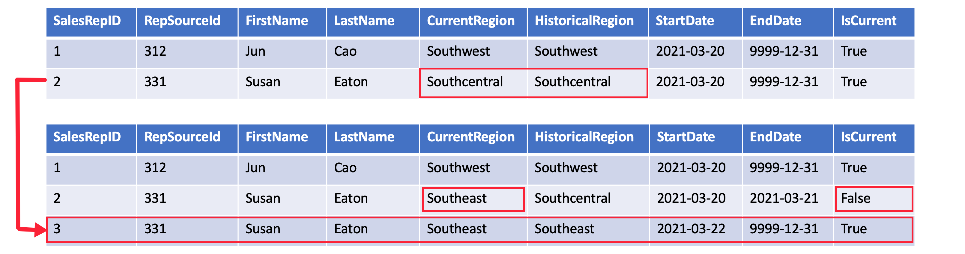
Populate slowly changing dimensions in Azure Synapse Analytics pipelines
SCD Type 1
SCD Type 2
SCD Type 3
SCD Type 6
Notes:
A Type 1 SCD always reflects the latest values, and when changes in source data are detected, the dimension table data is overwritten.
A **Type 2 SCD** supports versioning of dimension members. The dimension table must use a surrogate key to provide a unique reference to a version of the dimension member. It also includes columns that define the date range validity of the version (for example, `StartDate` and `EndDate`) and possibly a flag column (for example, `IsCurrent`) to easily filter by current dimension members.
A **Type 3 SCD** supports storing two versions of a dimension member as separate columns. The table includes a column for the current value of a member plus either the original or previous value of the member. So Type 3 uses additional columns to track one key instance of history, rather than storing additional rows to track each change like in a Type 2 SCD.
A **Type 6 SCD** combines Type 1, 2, and 3. When a change happens to a Type 2 member you create a new row with appropriate StartDate and EndDate. In Type 6 design you also store the current value in all versions of that entity so you can easily report on the current value or the historical value.
Instructor notes and guidance.
This slide is a build slide
Click 1 – brings in the SCD type 1 graphic
Click 2 – removes the SCD type 1 graphic
Click 3 – brings in the SCD type 2 graphic
Click 4 – removes the SCD type 2 graphic
Click 5 – brings in the SCD type 3 graphic
Click 6 – removes the SCD type 3 graphic
Click 7 – brings in the SCD type 6 graphic
Click 8 – removes the SCD type 6 graphic
Recommended reading for this slide
Populate slowly changing dimensions in Azure Synapse Analytics pipelines - Learn | Microsoft Docs

Slide 8
Perform code-free transformation at scale with Azure Data Factory or Azure Synapse Pipelines
3

Slide 9
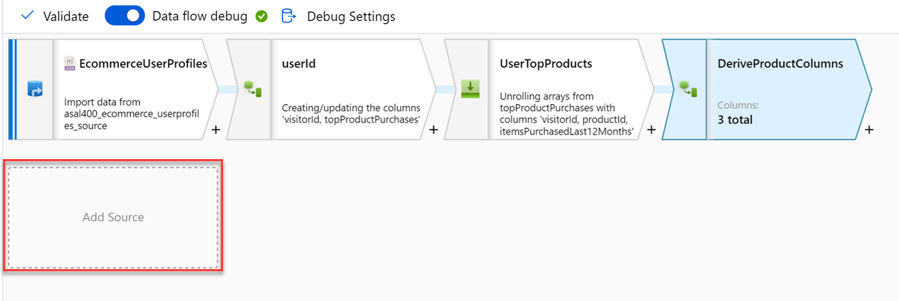
Code-free transformation at scale with Azure Data Factory or Azure Synapse Pipelines
Notes:
Talking points
Let’s dive into the data flow mapping
Mapping data flows are visually designed data transformations in Azure Data Factory or Azure Synapse Pipelines.
Data flows allow data engineers to develop graphical data transformation logic without writing code.
The resulting data flows are executed as activities within Azure Data Factory/Synapse pipelines that use scaled-out Spark clusters.
Data flow activities can be operationalized via existing Data Factory/Synapse Pipeline scheduling, control, flow, and monitoring capabilities. Mapping data flows provide a fully visual experience with no coding required.
Your data flows will run on your own execution cluster for scaled-out data processing. Azure Data Factory/Synapse handles all the code translation, path optimization, and execution of your data flow jobs.
Data Flow mapping brings the following benefits and capabilities:
- Perform data cleansing, transformation, aggregations, etc.
- Enables you to build resilient data flows in a code free environment
- Enable you to focus on building business logic and data transformation
- The underlying infrastructure is provisioned automatically with cloud scale via Spark execution
Like many data transformation tools, Mapping Data Flow in Azure Data factory supports a great variety of data transformations.
Instructor notes and guidance.
Note that this content is valid for both Azure Data Factory and Azure Synapse Pipelines. Consider showing an example through a demo, you should consider replaying some of the activities done in the lab. The feedback from MCTs about DP200 is that many students needed help the ADF lab, so replaying the mapping data flow should be considered.
Recommended reading for this slide
Code-free transformation at scale with Azure Data Factory - Learn | Microsoft Docs

Slide 10
LAB 1: Design and implement the serving layer
60 minutes
Notes:
TALKING POINTS​
​
Let’s put this into reality and show you how it works.​
​
All instructions and context are found in this repository​

